Slide 1

RED SUR
“The future of Extractive Industries and the Role of STI”
Alexandre Szklo
Associate Professor– COPPE/UFRJ
September 2016

Slide 3

Brazil´s Petroleum Scenarios Landscape
GHG mitigation challenges in the Upstream
GHG mitigation challenges in the Midstream
Final Remarks

Slide 4
Brazil´s Petroleum Scenarios Landscape
Challenges in the Upstream
Challenges in the Midstream
Final remarks

Slide 5

Landscape...
Sorry for some slides in portuguese
Sorry for not speaking Spanish. I won´t try the “portunhol”...

Slide 6

Brazil´s oil production (Scenarios to 2050)
Modelling...
  Cumulative production (detailed data by field)
  Reserves and resources (data by field. CAPEX. OPEX)
  Pre-salt:
    Three fiscal systems: tax and royalty. production sharing (PSC) and onerous assignment agreement (see doi:10.1093/jwelb/jwt014)
    Major fields already under development/production
  Yet-to-find resources (pre-salt. onshore. equatorial margind frontier) plus EOR in mature fields (“post-salt” fields)
  Supply curve and oil price

Slide 7
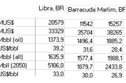

Slide 8
A: Post-salt B: Pre-salt (tax/roylaty plus onerous assignement) C: Presalt (PSC) D: Other fields Novas: yet-to-find plus EOR

Slide 9

But the devils is in the details... (or in the porous of sedimentar rocks)

Slide 10
(Unitization...)
Tax and royalty
PSC
Field/Block | Remaining oil reserves (mmbbl)
Tartaruga Verde/Tartaruga Mestiça | 346
Gato do Mato | n/a
Lula e Sul de Lula | 6384
Sapinhoá | 1626
Carcará | 460
Epitonium | n/a
Carapeba | 17
Caxareu | n/a
Pirambu | 32
Massa (Nautilus) | 27
BM-C-34 | n/a
BM-C-32 | 2005
Iara/Entorno de Iara | 2902
MBMS-24 Jupiter | n/a
Sul de Sapinhoa | 192
Buzio/Franco | 2894
Sepia (NE Tupi) with Jupiter | 398
Libra | 5943
Total (min) | 23.226
YTF
...)

Slide 11
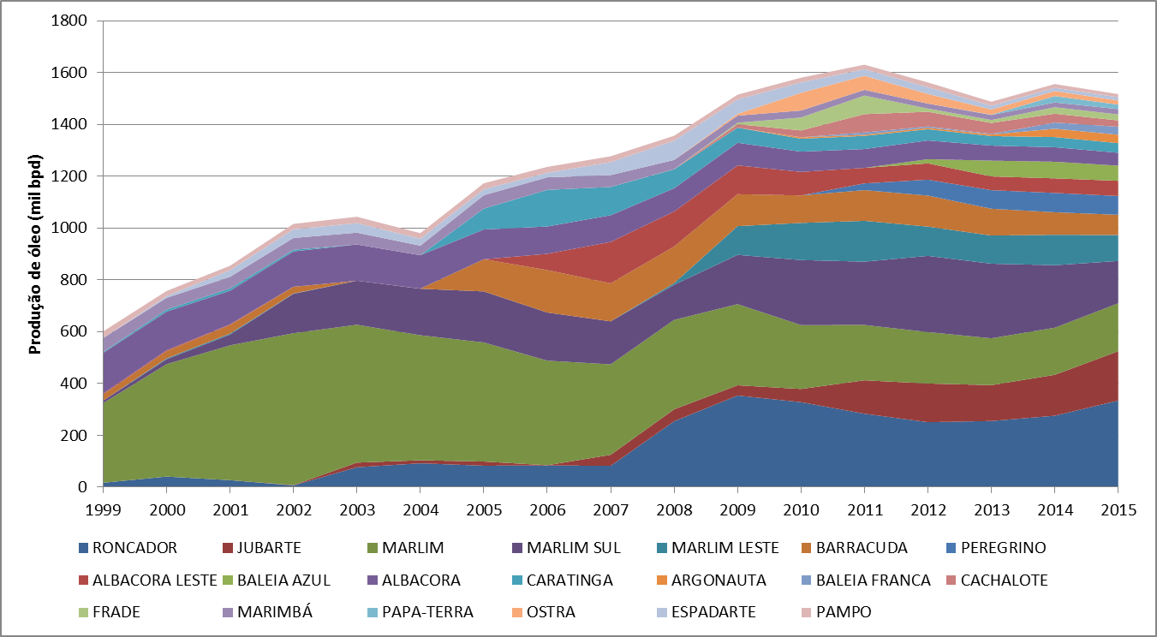
(EOR in post-salt mature fields...

Slide 12
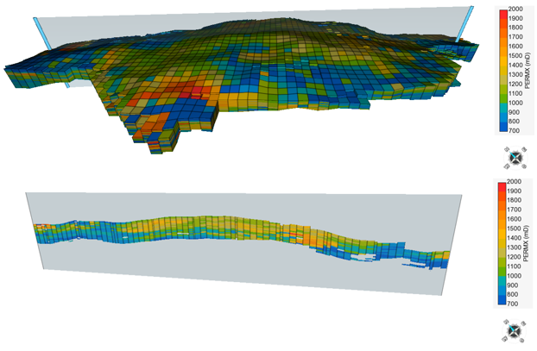
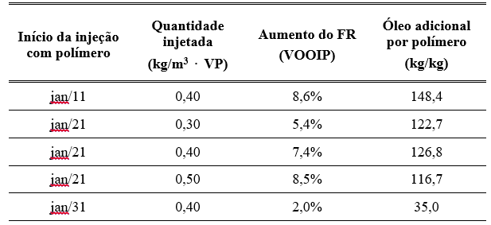
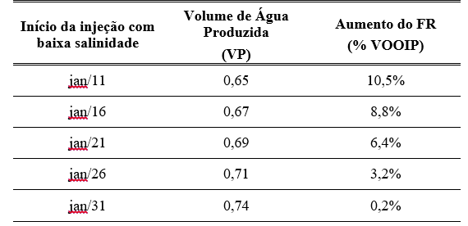
...)
Campos Field – Modelling EOR

Slide 13
(Local content...)

Slide 14

(PB in the crossroad)
Are petroleum resources strategic?
Should PB be a company to manage petroleum resources in Brazil?
Should PB manage all liquid fuels in Brazil?
Should PB support all energy policies in Brazil (including financing policies related to electricity)?
Should PB finance/support energy. regional. social. macroeconomic… policies?
How to deal with overruns (cost and construction time)?

Slide 15
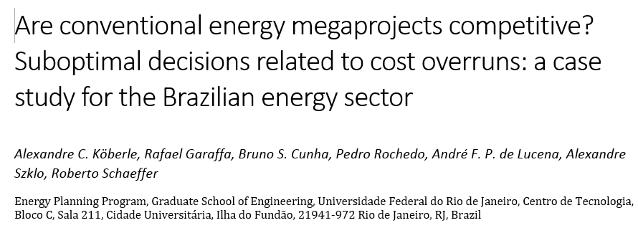

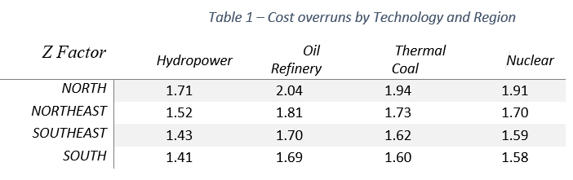

Slide 16
Brazil´s Petroleum Scenarios Landscape
GHG mitigation Challenges in the Upstream
GHG mitigation challenges in the Midstream
Final Remarks

Slide 17
Brazil´s energy production/conversion facilities – GHG emissions (results from MSB 8000)
Baseline
http://www.iddri.org/Publications/Collections/Analyses/MILES%20report.pdf

Slide 18

BC0:
Mitigation in E&P
UHE repowering
-41%

Slide 19
BC25:
CCS in UGH (oil refineries)
Bio-CCS in etanol distilleries
Small-scale hydro turbines
PES
-64%

Slide 20
BC50
Solar PV
Repowering bagasse fired generation (IGCC)
CCS in UTEs coal
-86%

Slide 21
Carbon cost
Emissions

Slide 22
Associated NG in pre-salt fields (non usual high CO₂ content)

Slide 23
CCS in pre-salt fields
See http://dx.doi.org/10.1016/j.jclepro.2016.05.033

Slide 25
Other GHG mitigation options for upstream activities in Brazil
  Steam recovery in storage tanks (URV): can be used for electric power generation in ORC (e.g.) to save natural gas.
  Gas sealing : to reduce fugitive emissions
  Controlling fugitive emissions in compressors
  Maintenance program for controlling fugitive emissions
  Flare ignition system
  GTL (Gas to liquids)
  Heat recovering of off-design gas turbine to power ORC cycles

Slide 26
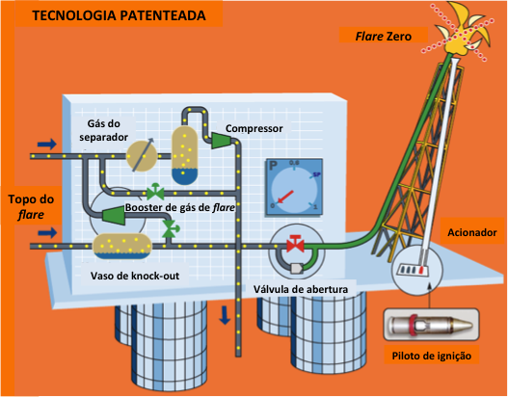
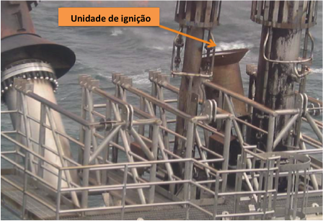
Flare ignition system

Slide 27
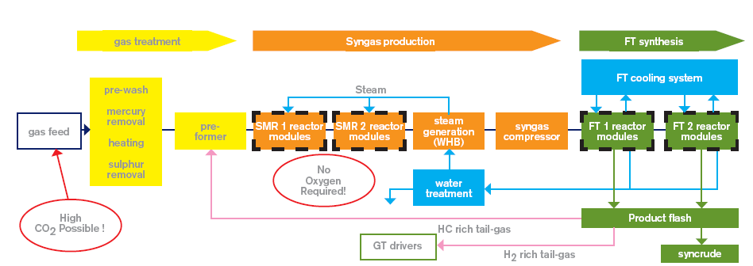
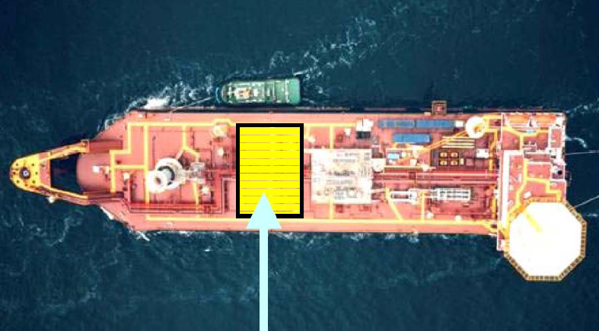

GTL

Slide 28
ORC – off design gas turbines in FPSOs

Slide 29
Simulations for a FPSO (80 kbpd)

Slide 30
 | Abatement cost and potential by FPSO
 | Post-salt |  |  | Pre-Salt
 | 100 bpd |  |  | 100 bpd |  |  | 150 bpd |  |  | 200 bpd
 | AE | Gross | Net | AE | Gross | Net | AE | Gross | Net | AE | Gross | Net
URV | 61.9 | 4.5 | -35.0 | 80.4 | 4.1 | -35.4 | 120.6 | 4.1 | -35.4 | 160.8 | 4.1 | -35.4
Gas sealing | 21.9 | 74.6 | 58.8 | 43.8 | 74.6 | 58.8 | 65.7 | 49.7 | 33.9 | 87.6 | 37.3 | 21.5
Fugitive emissions in compressors | 0.11 | 45.72 | 29.07 | 0.11 | 45.72 | 29.07 | 0.16 | 30.48 | 13.83 | 0.21 | 22.86 | 6.21
Maintenance Program | 8.4 | 43.1 | 26.4 | 8.4 | 43.1 | 26.4 | 12.6 | 29.8 | 13.2 | 16.8 | 23.2 | 6.6
Flare igntion system | 130.5 | 50.3 | -59.7 | 125.4 | 50.3 | -59.7 | 188.1 | 50.3 | -59.7 | 250.8 | 50.3 | -59.7
GTL | N/A¹ | 217.9 | -382.8 | n/a
Total: 106.38 MtCO₂e
Note: AE: Avoided emissions (ktCO₂e/year);
Gross: cost wo revenue(US$/tCO₂e) ;
Net: cost w/ revenue (US$/tCO₂e).

Slide 31
Brazil´s Petroleum Scenarios Landscape
GHG mitigation Challenges in the Upstream
GHG mitigation challenges in the Midstream
Final Remarks

Slide 32
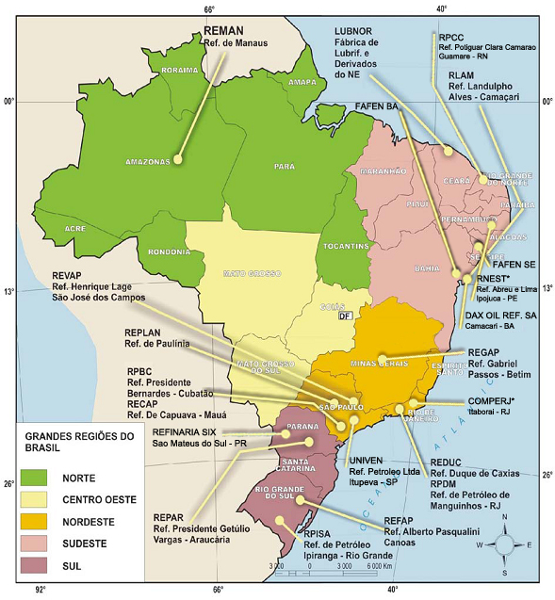
  2.1 Mbbl/dia primary capacity

Slide 33
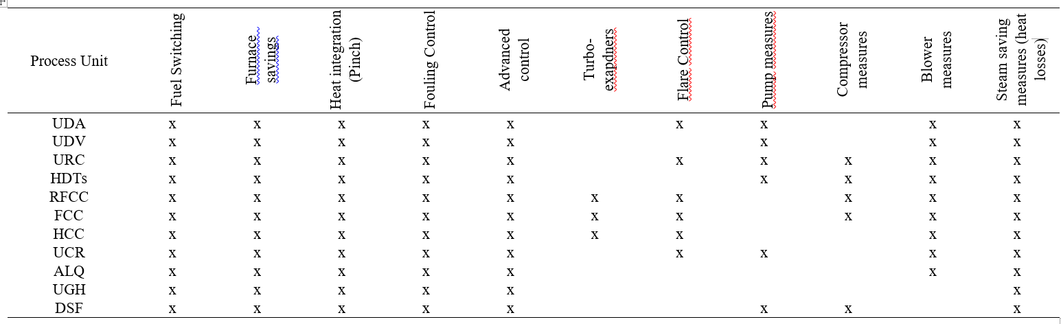

Slide 34
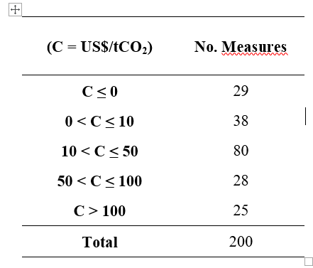

Slide 35
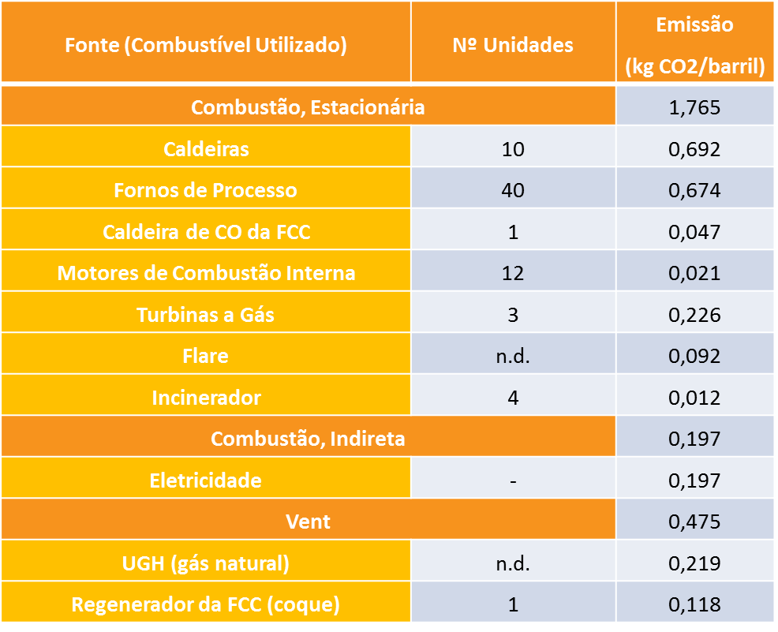
Carbon capture in Brazilian oil refineries
GHG emission sources
  Boilers and furnaces
    Low CO₂ pressure = low content
    Dispersed sources
  CHP
    Low CO₂ pressure = low content
  FCC regenerator
    Medium content (10-20%mol): Brazil´s average = 12% mol
  HGU
    High pressure
    Medium to high content (~20%mol)
    NG steam reform: ~9 tCO2/tH₂
See http://dx.doi.org/10.1016/j.jclepro.2016.05.033

Slide 36
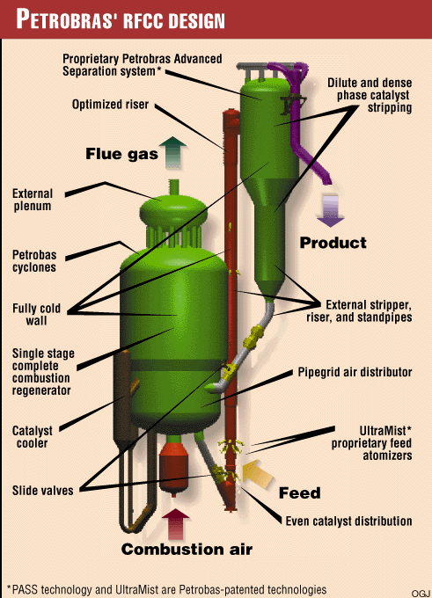
FCC and RFCC regenerators
Proposed capture route: oxycombustion: CO₂ content after combustion = 85 - 99% mol
CO₂ abatement cost – energy-mass balances simulations in IECM®: 74 US$/tCO₂
Abatement potential (all BR refineries): 7.6 MtCO₂/year
  25% of GHG emissions in BR oil refineries
  Installed capacity: 73.5 km³/dia
However, “the addition of capture requires a footprint that would hardly be available in most existing refineries in Brazil .”

Slide 37
HGU
Carbon capture potential of 7.0 MtCO₂ per year.

Slide 38
Brazil´s Petroleum Scenarios Landscape
GHG mitigation Challenges in the Upstream
GHG mitigation challenges in the Midstream
Final Remarks

Slide 39
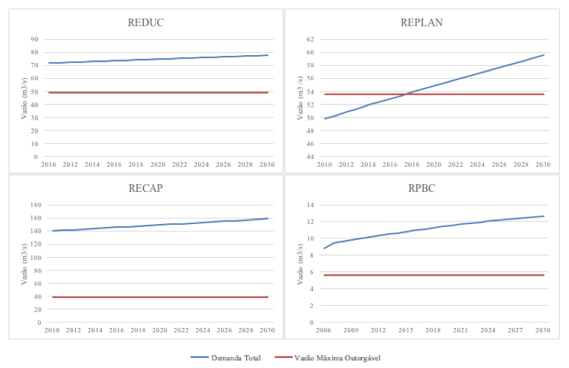
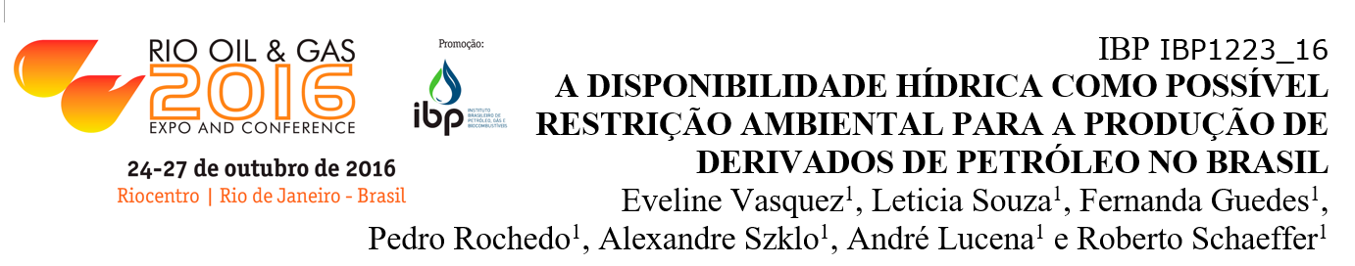
Environment is more than GHG emissions
E.g. water pressure...

Slide 40
Public policies
Why do some non-regret BATs fail?
Barriers
  Economic:
    Capital cost
    Discount rate
  Technology:
    Lock-in
    Risk aversion
  Information:
    Lack of knowledge;
    Focus on core business

Slide 41
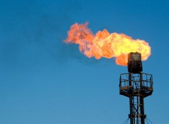
e.g. Flare Control
Main barriers: lack of information and safety/risk aversion (offshore conditions)
R&DD
  Pilot projects for flare ignition system
  Use of R&D resources – 0.5% of petroleum production gross revenue (ANP. 2012)
Command and control
  Limiting flare (flare already “pays” royalty in Brazil)

Slide 42
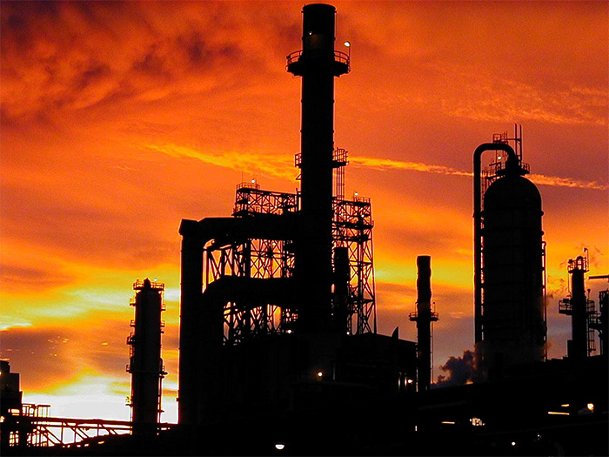
e.g. Energy efficiency
Main barriers: information, lock-in, footprint, loss of revenue during implementation
Information
  Technical roadmaps
  Building capacity
Command and control
  Minimum efficiency targets / maximum emission targets
  Quality certification for products and process
  Energy efficiency programs for FPSOs and oil refineries
R&DD
  Innovative processes (process intensification, process integration,
  S2S - subsea-to-shore…)

Slide 43
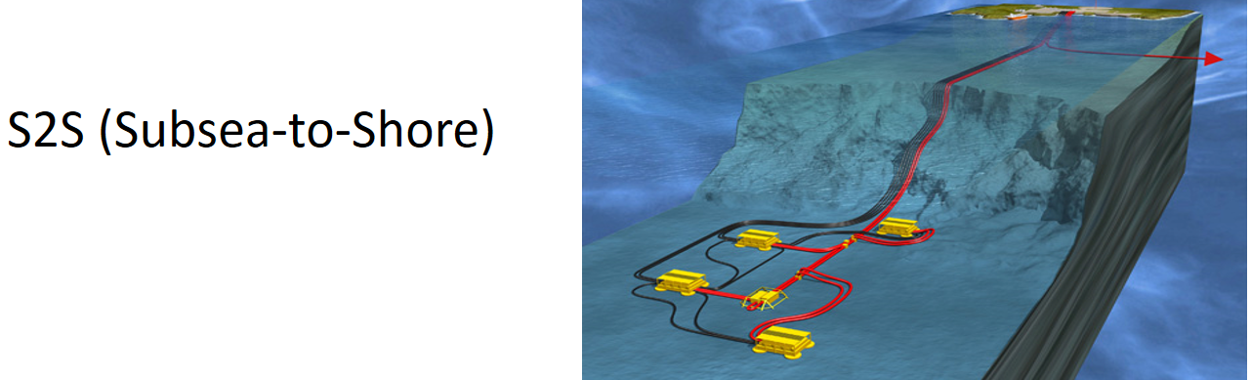
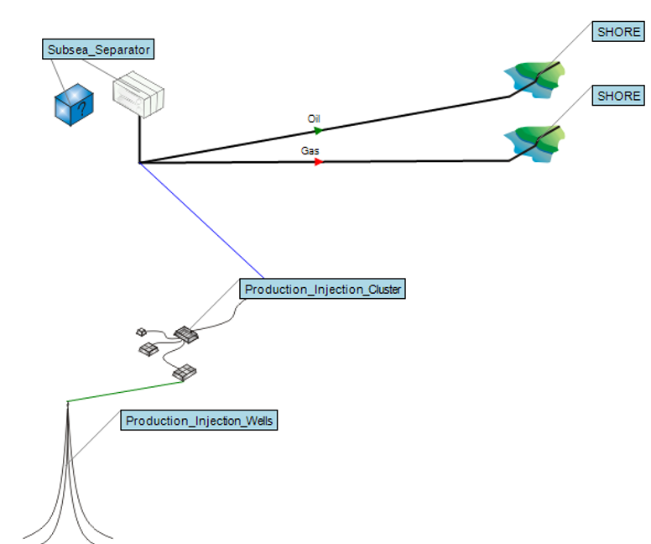
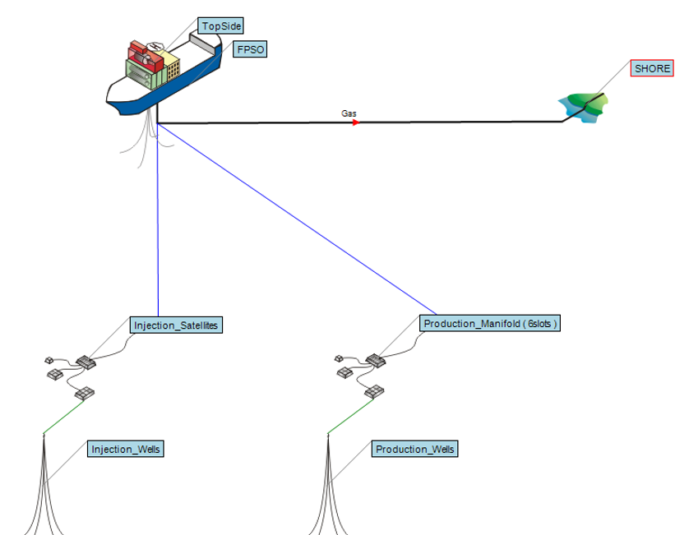
Segen, 2016

Slide 44
e.g. Carbon capture
Main barriers: cost, scale, footprint, regulatory uncertainties
Upstream: membranes in pre-salt
Midstream: Quite old refineries, limited space, low refinery margins (history of oil products price control)
CO₂-EOR perspectives for some fields

Slide 45
Thanks
szklo@ppe.ufrj.br
www.coppe.ufrj.br

